Slide 1



Marketing Cumulative - Sample
View in Power BI
Last data refresh:
5/26/2018 2:19:49 PM Romance Standard Time
Downloaded at:
12/19/2018 3:33:45 PM Romance Standard Time

Slide 2
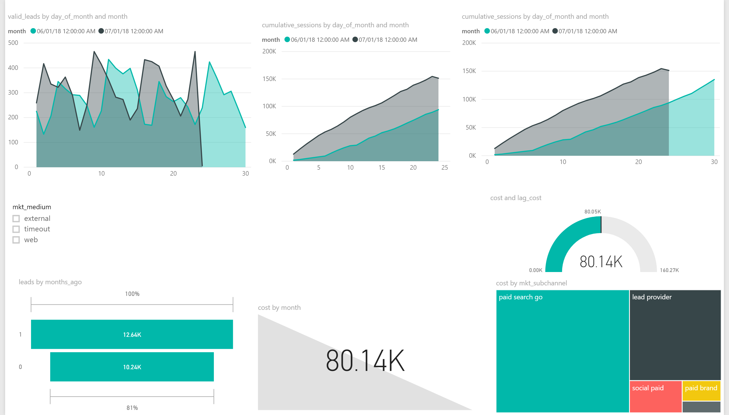

Slide 3
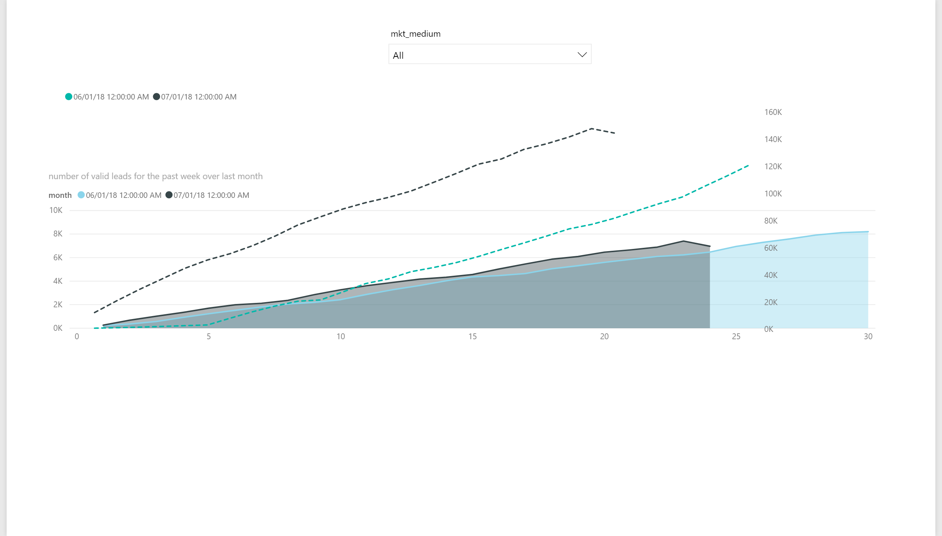

Slide 4
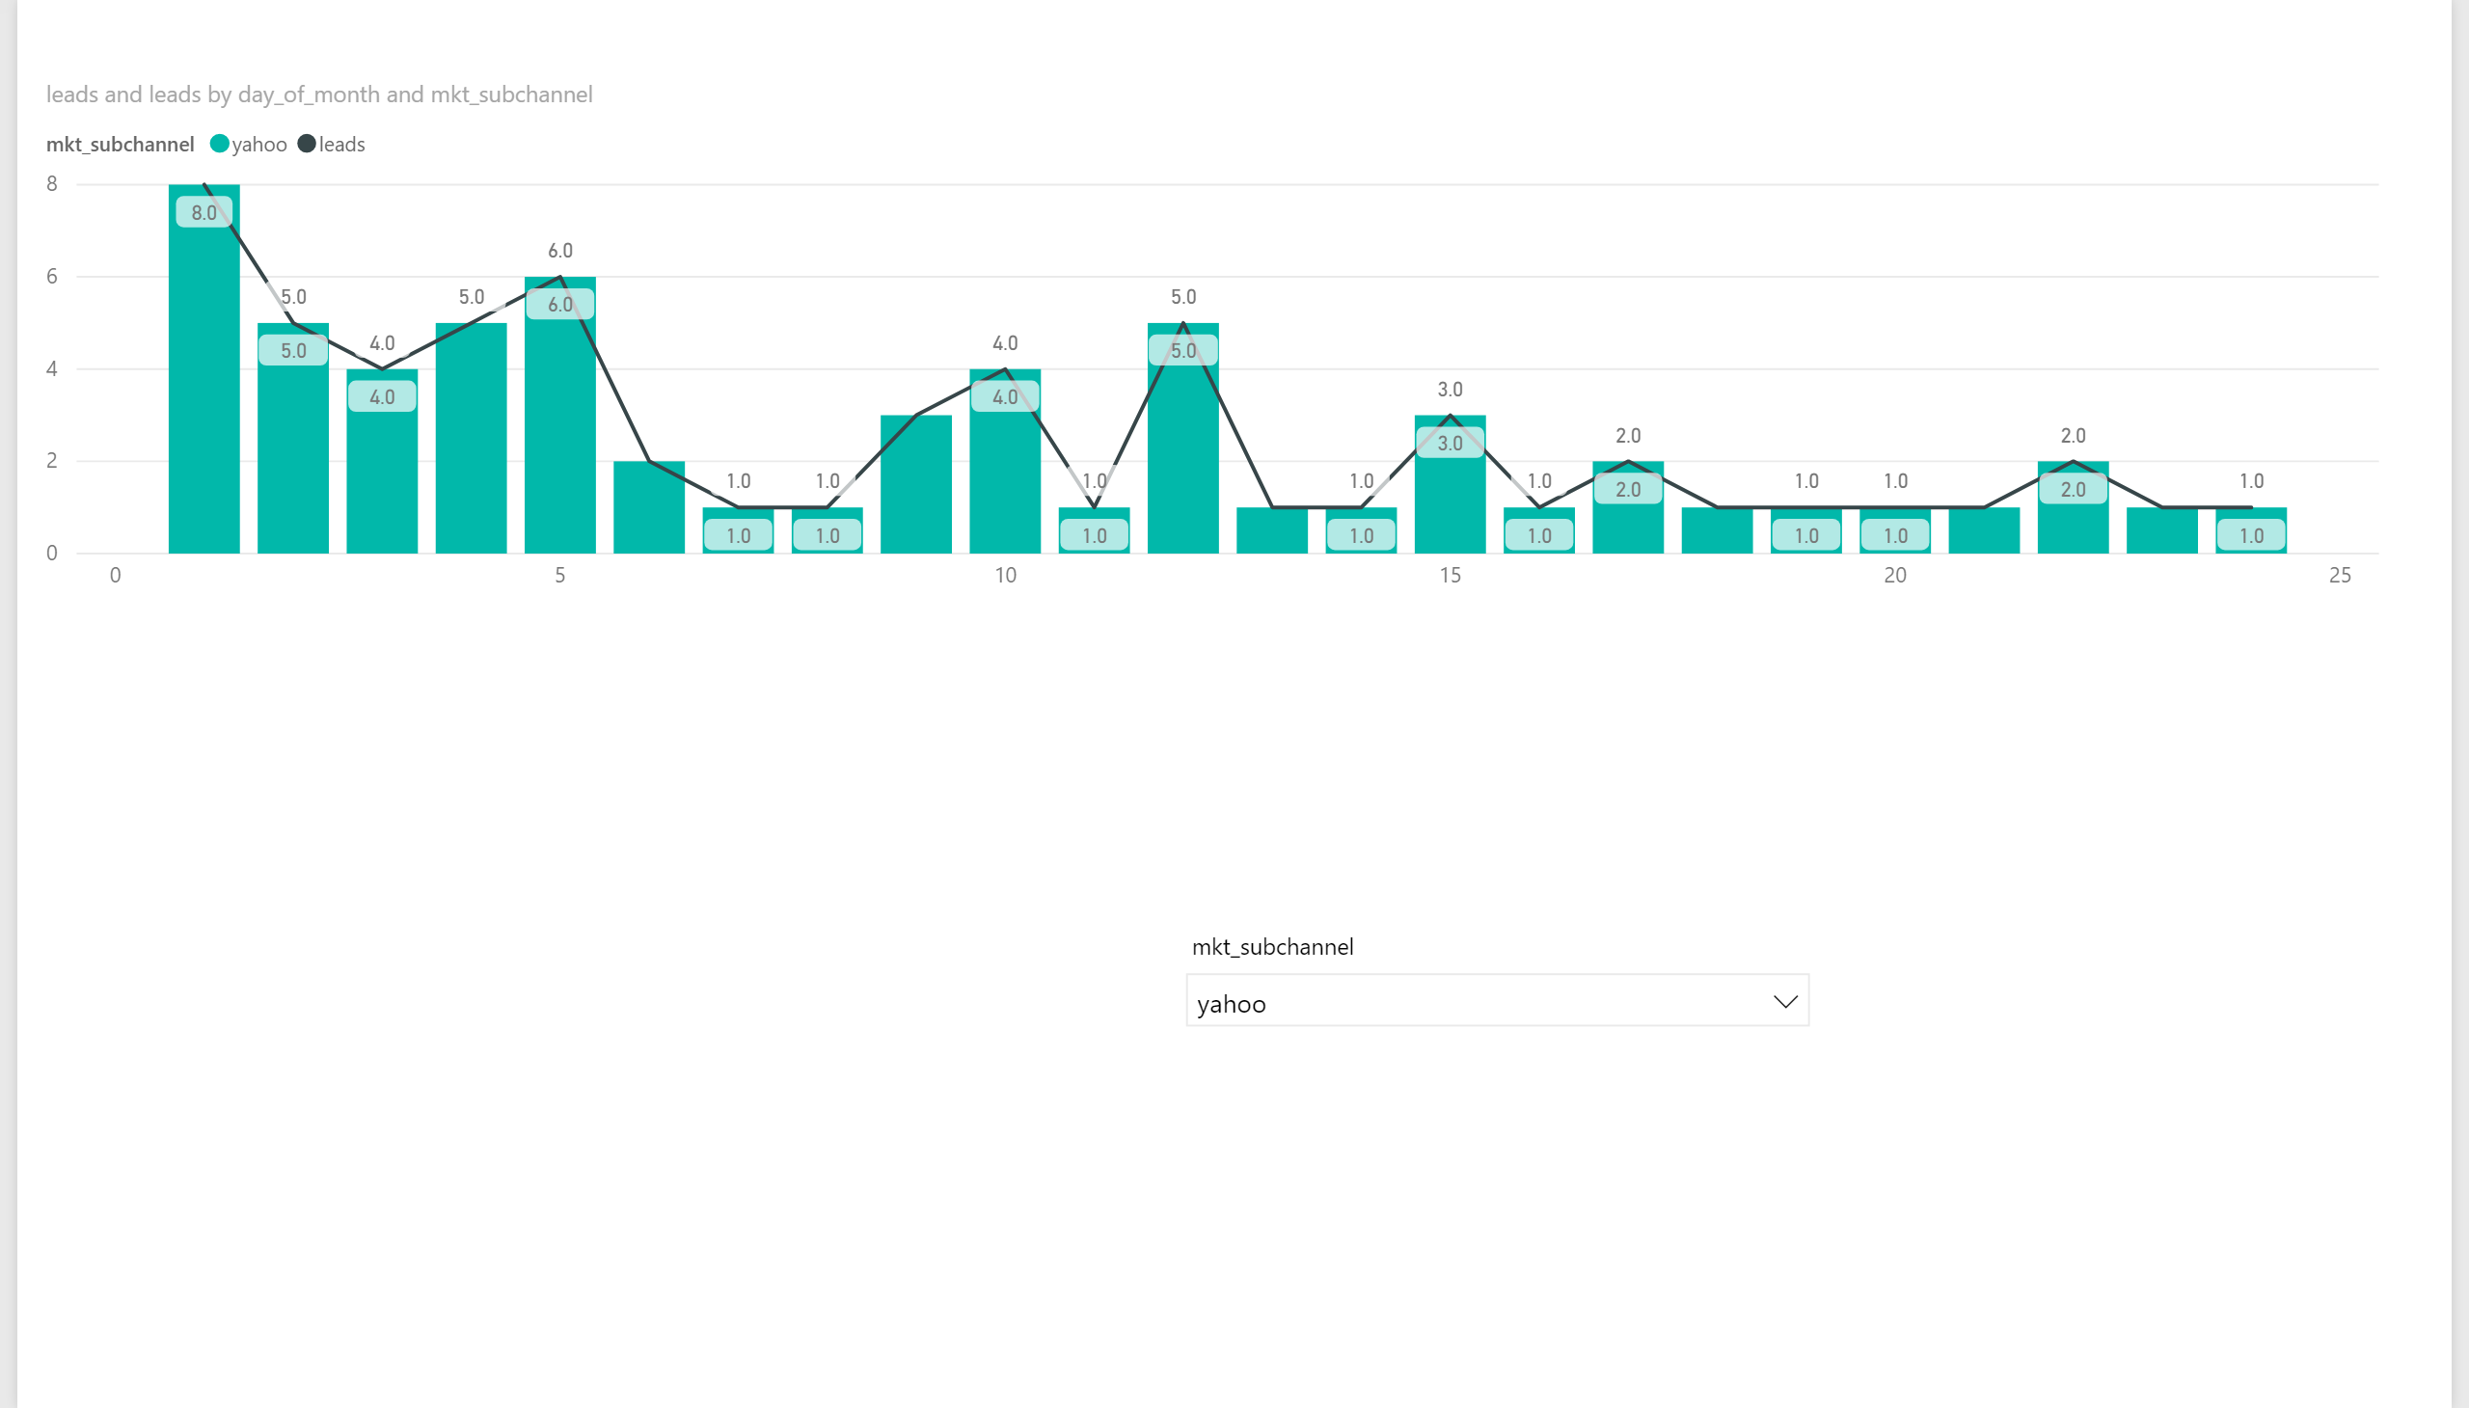

Slide 5
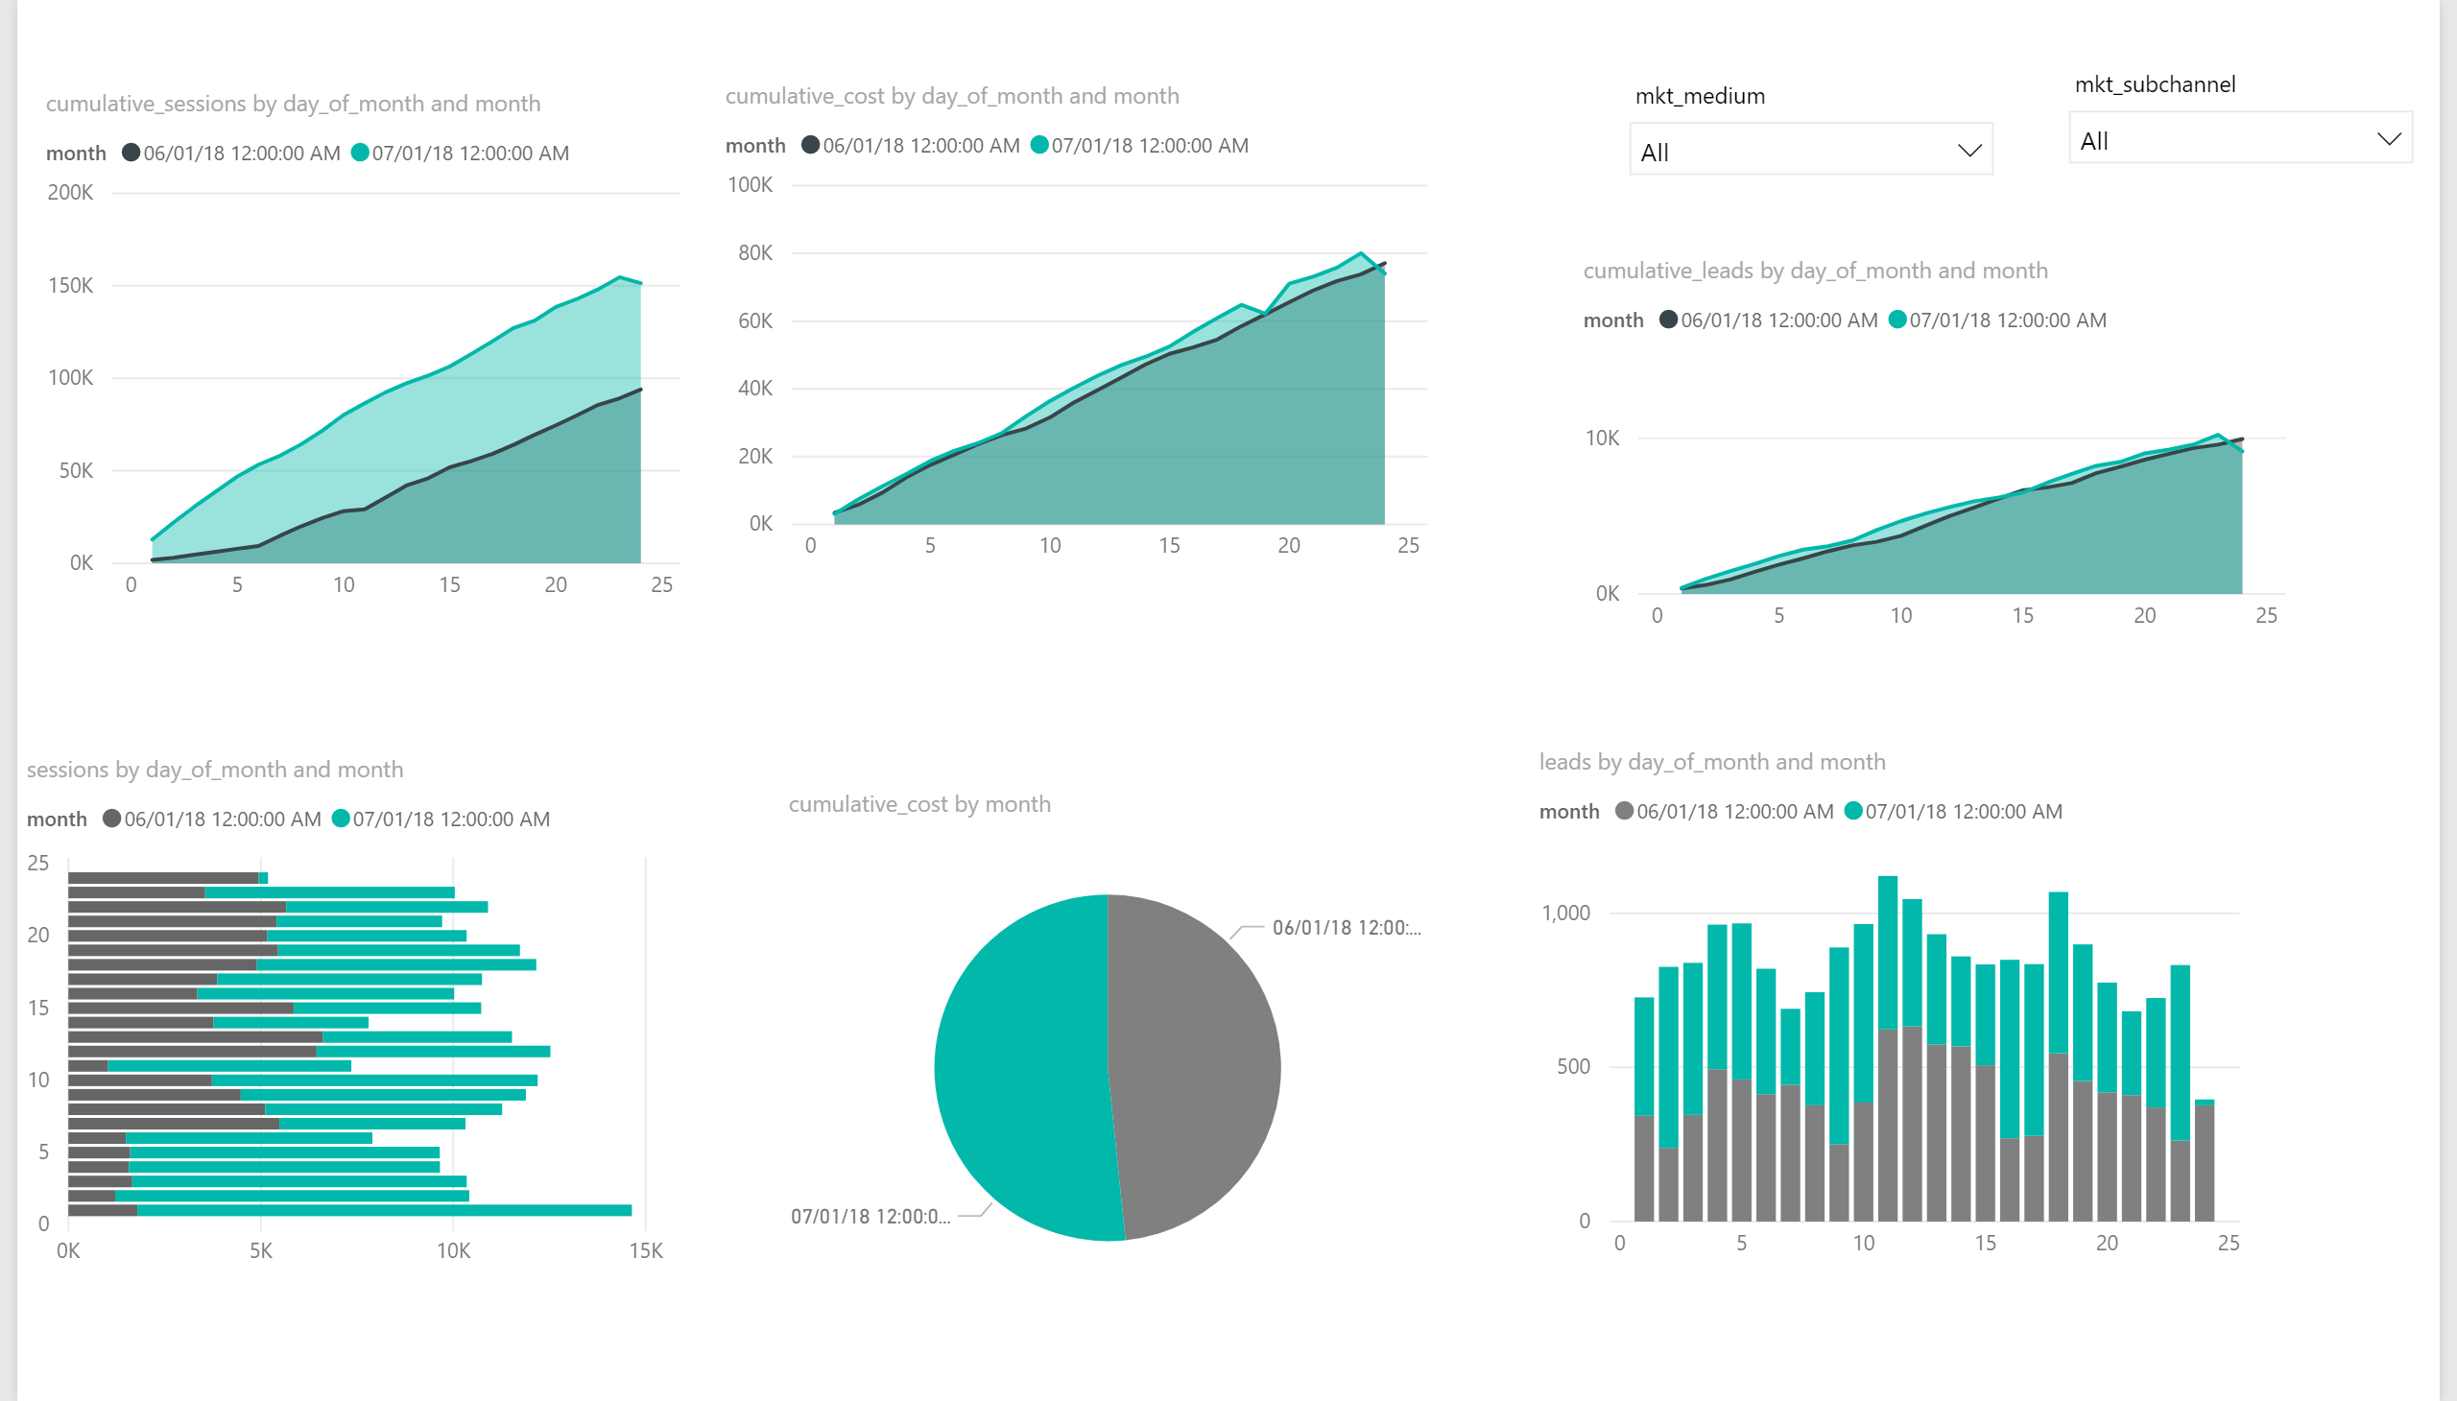

Slide 6
